Slide 1
I210 Information Infrastructure
Lab 5

Slide 2
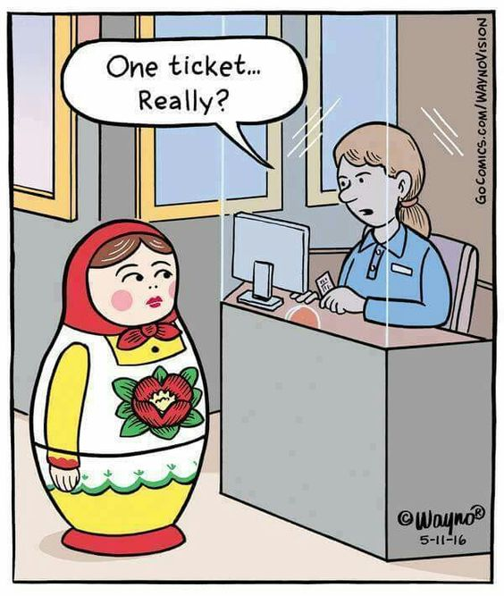
Today
Nested sequences!

Slide 3
Quick Review – Nested Sequences
Items in Lists and Tuples can also be other Lists and Tuples:
nested_list = [ ("Python","PHP"), "Hello", [2.3, 4] ]
nested_tuple = ( ("Python","PHP"), "Hello", [2.3, 4] )
Ok, so we can truly mix and match what items are in our lists or tuples.

Slide 4
Quick Review – Nested Sequences
scores = [ ("Max", 200), ("Ava", 180), ("Seth", 215) ]
If the nesting happens in a pattern like this, we can think of our nested list as a table:
 | Name | Score
Row 0 | “Max” | 200
Row 1 | “Ava” | 180
Row 2 | “Seth” | 215

Slide 5
When to Use Nested Sequences?
ASK:
Do I need to store multiple pieces of data?
Does each piece of data need multiple parts?
Would a table make sense to represent my data?
AIs / UIs share your opinions on this:
When is a good time to use a nested sequence?

Slide 6

DINOSAURS
As part of IU Geology, you take a trip to Montana. Your group discovers fossilized dinosaur nests! Can you help your team better organize and display their data?

Slide 7
Nest the Sequence (Group Work)
With your group, put the following basic dinosaur data into a nested sequence:
Dinosaurs | Name | Weight in Lbs | Description | Period
Row 0 | Tyrannosaurus | 16000 | carnivore | Late Cretaceous
Row 1 | Ankylosaurus | 10000 | herbivore | Late Cretaceous
Row 2 | Stegosaurus | 6000 | herbivore | Late Jurassic
Row 3 | Deinonychus | 175 | carnivore | Early Cretaceous

Slide 8
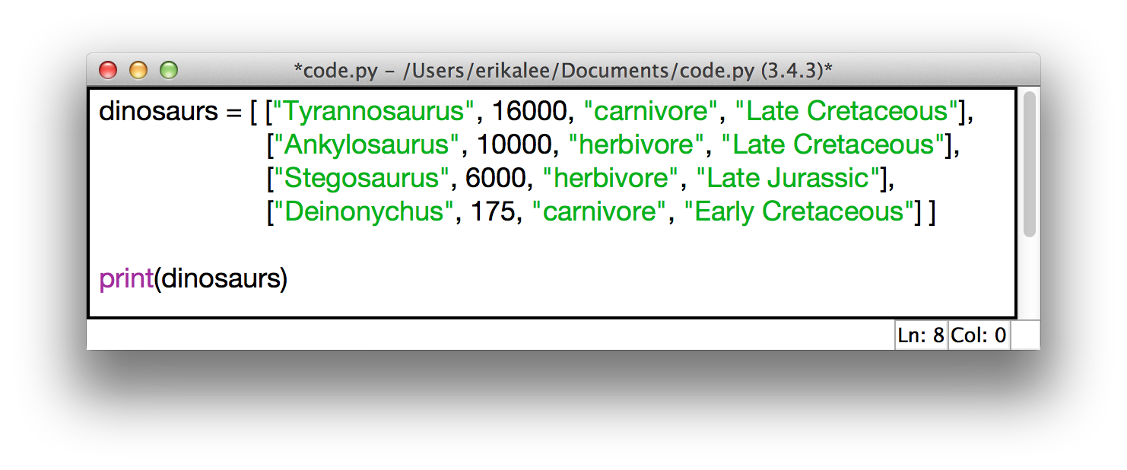
Nest the Sequence (Solution)

Slide 9
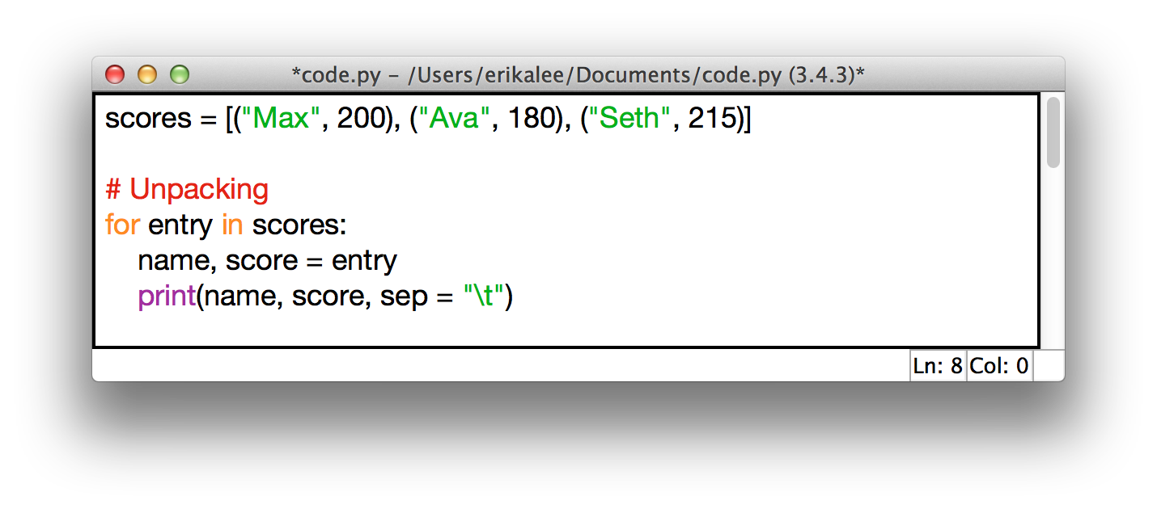
Quick Review – Nested Sequences
If we know exactly how many pieces are in the inner sequence, we can do what’s called unpacking.
This assigns the pieces of the inner sequence to multiple variables at once! This can be better when using entry[0] or entry[1] is confusing.
Output:
>>>
Max 200
Ava 180
Seth 215
>>>

Slide 10
Review - Formatting Output
Let’s say we want to print out a date as Month Day, Year:
month = "May"
day = 23
year = 2016
output = "{0} {1}, {2}"
print(output.format(month, day, year))
>> May 23, 2016
Notice that .format also converts the ints to strings.
0, 1, 2, etc… represent index positions -- which variable passed to .format() should be displayed.

Slide 11
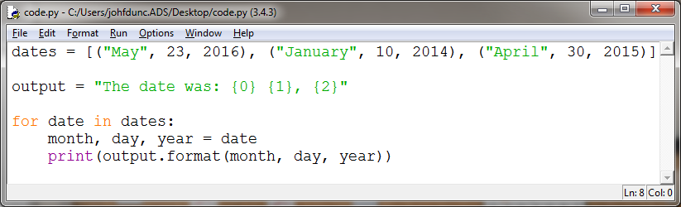
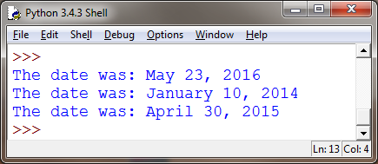
Review - Formatting Output
If we need to print out several dates, it's now very easy to do so by changing the variables we pass to .format()

Slide 12
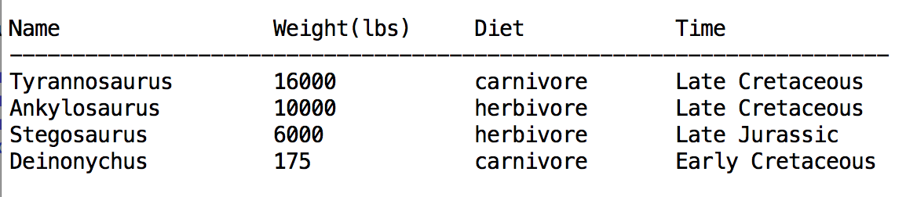
Unpack the Sequence (Group Work)
Use unpacking and the .format() method to print the data about each dinosaur in a nicely spaced table.
Note: you might have to convert the weight to a string to get it to play nice when printing.

Slide 13
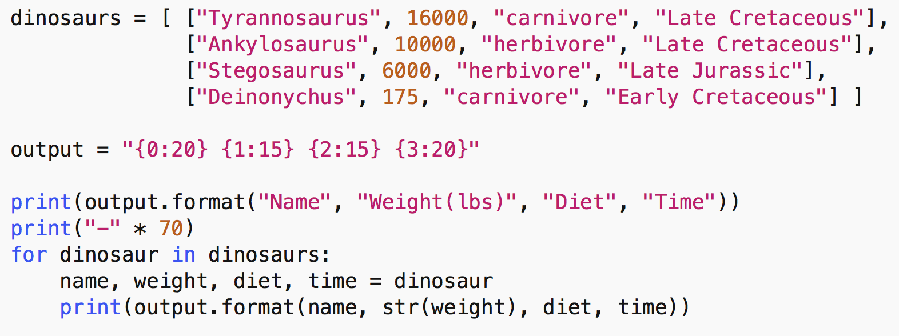
Unpack the Sequence (Solution)

Slide 14

Great work! Now that you’ve helped organize the data, create a way for your team to keep track of each dinosaur’s nest and the number of fossilized eggs found.

Slide 15
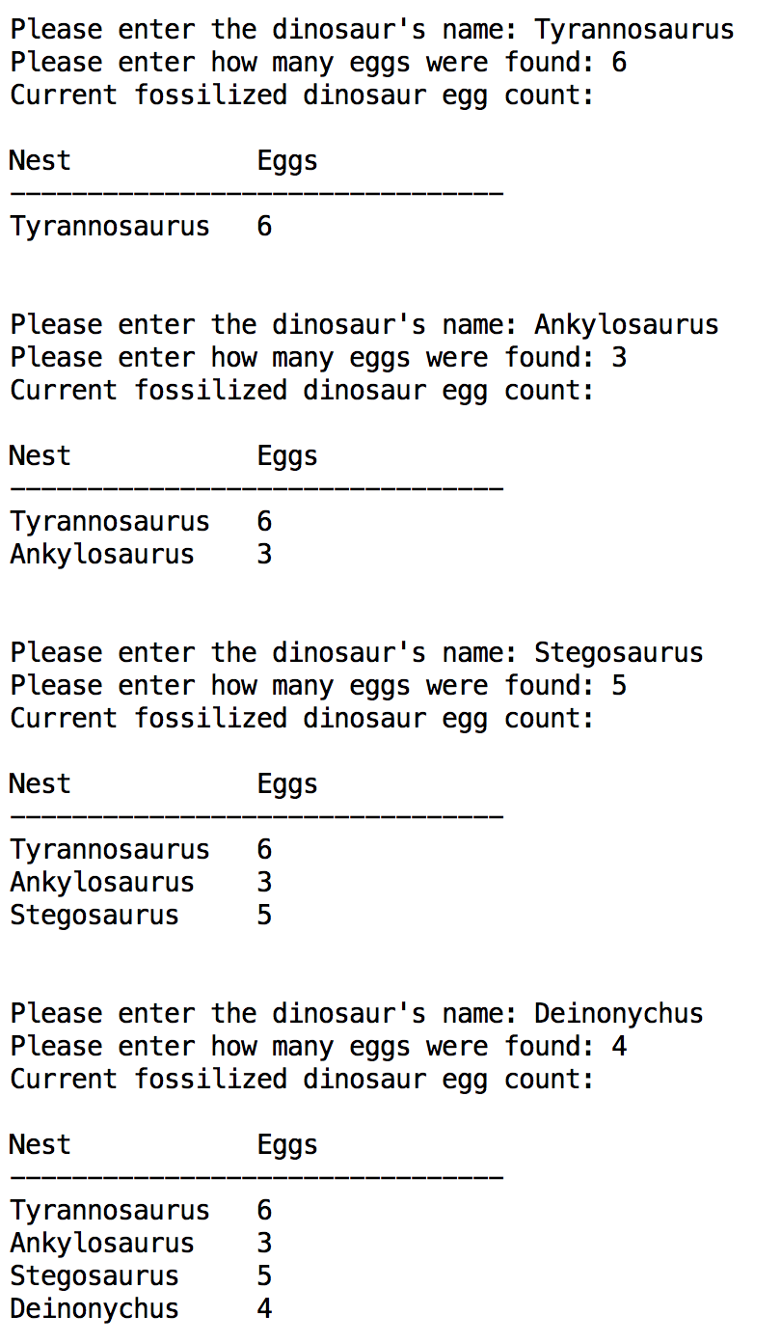
Table Print 4
Use table_print v3 to complete this problem. The code in this function doesn’t change!!
Enter each dinosaur’s name (which nest found) and how many eggs, individually. Display all names and number of eggs found after each entry.
We’ll use the 3rd argument (padding) to table_print to automatically re-size the table as larger values are entered!
Remember: ‘\n’ = new line

Slide 16
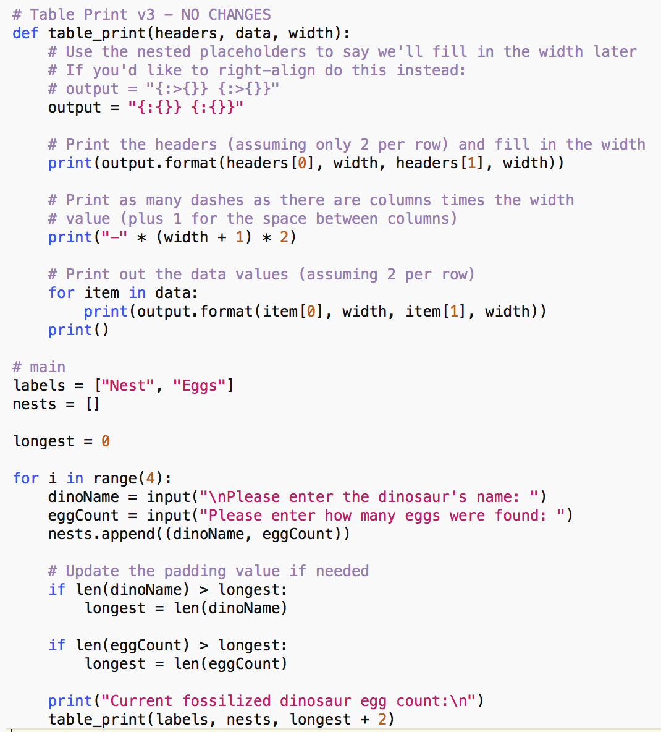
Table Print 4 (Solution)

Slide 17
Questions?

Slide 18
I210 Information Infrastructure
Lab 5

Slide 19
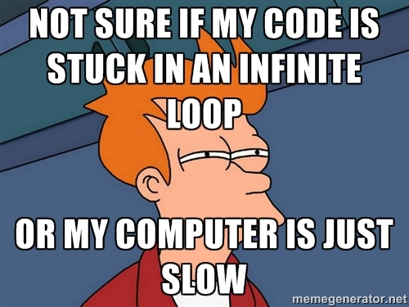
Topic
Today’s focus is files & while loops.

Slide 20
Quick Review - Basic File Use
#Either of these opens a file, reads it in as a string,
#prints out the string, then closes the file.
text_file = open("test.txt", "r")
file_contents = text_file.read()
text_file.close()
print(file_contents)
text_file = open("test.txt", "r")
file_contents = text_file.read()
print(file_contents)
text_file.close()

Slide 21
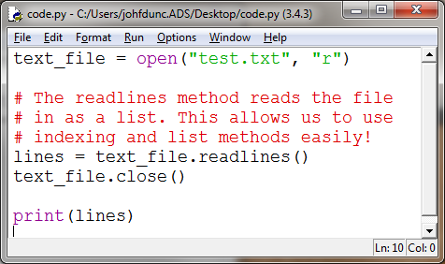
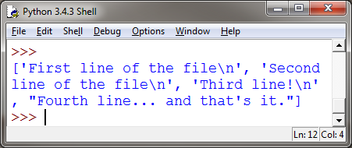
Quick Review - Reading from Files
You can also read lines into a list: (our default if you want to use list methods!)

Slide 22
Quick Review - Writing to a File
Make sure you close the file after writing to it!!
Nothing is actually written until you close the file.
text_file = open("write_it.txt", "w")
text_file.write("Line 1\n")
text_file.write("This is line 2\n")
text_file.write("That makes this line 3\n")
text_file.close()

Slide 23
Quick Review - Writing to a File
We can write from a list to a file:
lines = ["Line 1\n", "This is line 2\n", "That makes this line 3\n"]
text_file.writelines(lines)
Line 1
This is line 2
That makes this line 3
Lists are a great intermediary data structure for files!

Slide 24
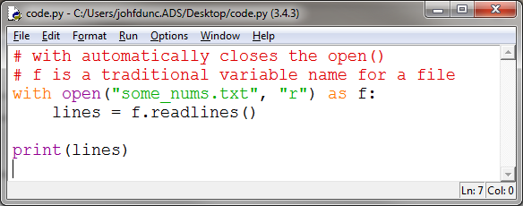
Quick Review - Files
This is an alternate way to interact with a file:
The with keyword creates a code block. After that code block finishes, the file is automatically closed!

Slide 25
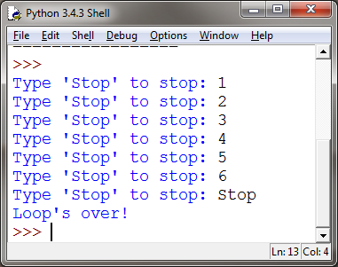
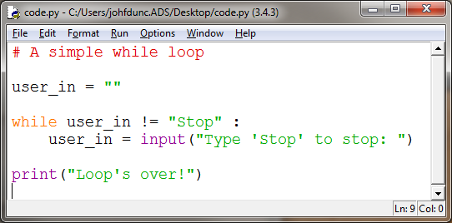
Quick Review - While loops

Slide 26
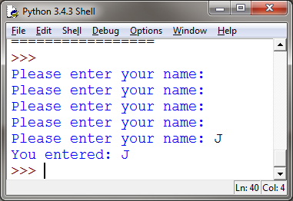
Quick Review - The break statement
while True:
name = input("Please enter your name: ")
# end loop if user enters something (Remember, "" is False)
if name:
break # appears on a line by itself!
print("You entered:", name)
while True: intentionally infinite loop
You must provide a break statement to leave the loop!

Slide 27
When to Use While Loops?
When is a good time to use a while loop?
Do you know many times a loop needs to run?
Are you validating an input?
(AIs / UIs share opinions on this)

Slide 28
Write a While (Group Work)
Write the first line of a while loop that would:
Run as long as the value of number was less than 100
Run until the value of username was a non-empty string.
Run until the variable cars contains an integer.

Slide 29
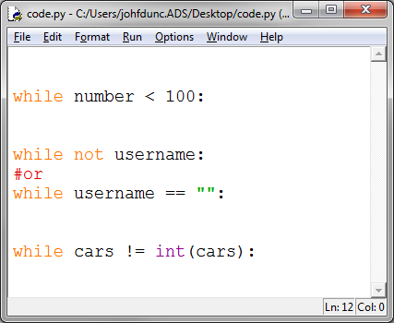
Write a While (Solution)

Slide 30
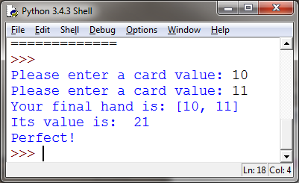
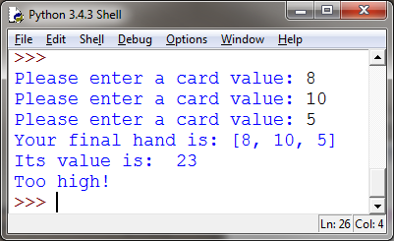
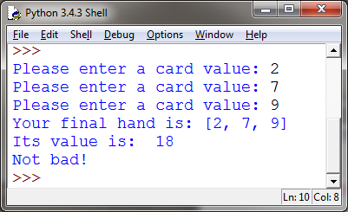
Blackjack (Group Work)
Write a program that simulates part of the Blackjack card game. Ask the user to enter each card’s value (a card can be worth between 1 and 11 points).
Run until the user hits 21, exceeds 21, or has 3 cards.

Slide 31
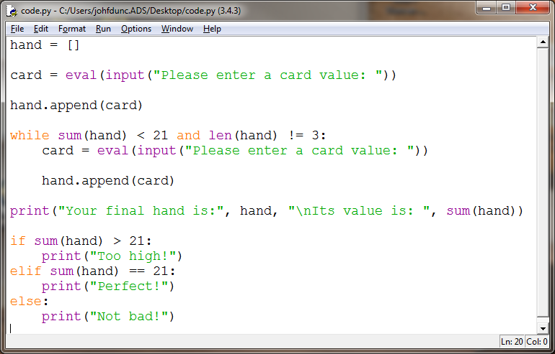
Blackjack (Solution 1)

Slide 32
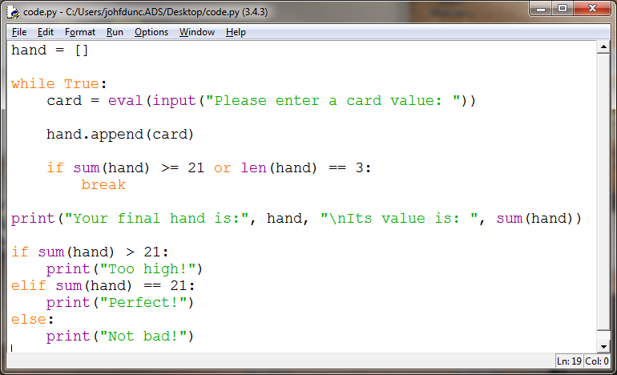
Blackjack (Solution 2)

Slide 33
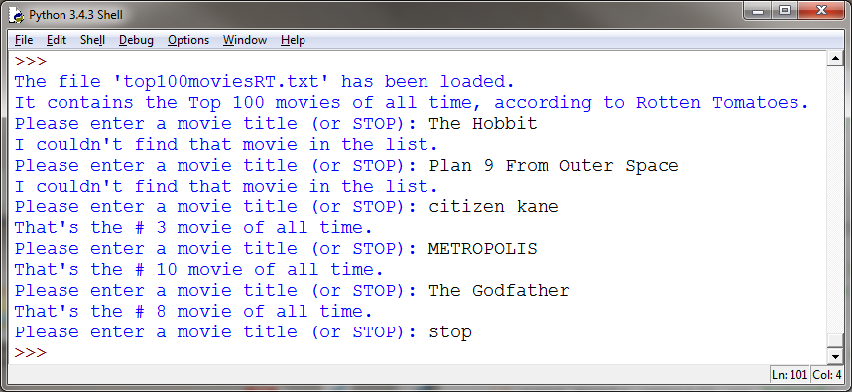
Top 100 Movies
Download the file top100moviesRT.txt from Canvas.
Replicate this program:

Slide 34
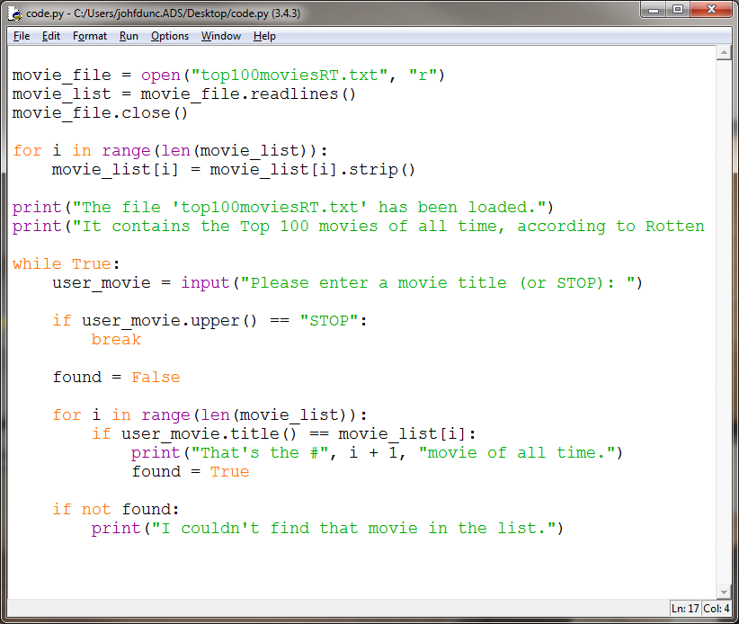
Top 100 Movies (Solution 1)

Slide 35
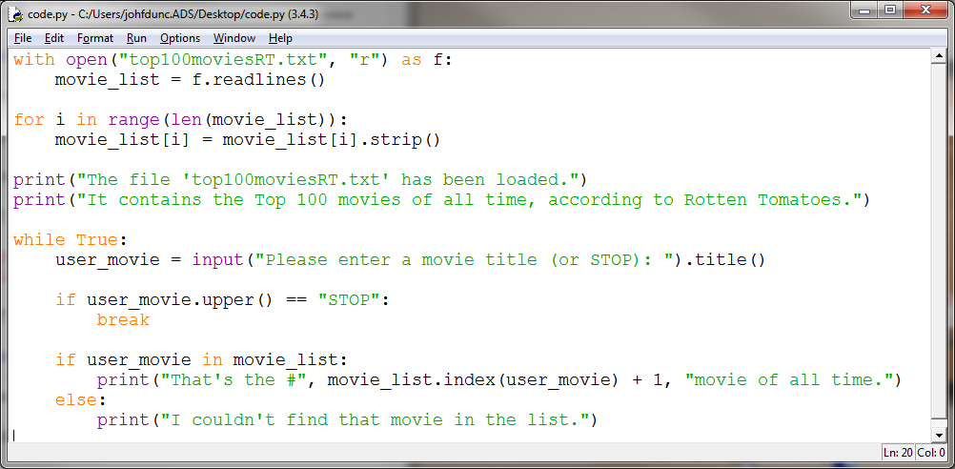
Top 100 Movies (Solution 2)

Slide 36
Questions?

Slide 37
I210 Information Infrastructure
Lab 5

Slide 38
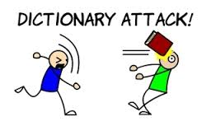
Topic
Today’s focus is dictionaries.

Slide 39
Quick Review - Dictionaries
Dictionaries use this format:
# notice the { } here!
indiana_terms = { "IU": "Indiana's flagship university",
"Purdue": "Clearly not as good, right?",
"cardinal": "Official state bird of Indiana",
"hoosier": "Name for someone living in Indiana” }
print( indiana_terms["cardinal"] )
>>>
Official state bird of Indiana

Slide 40
When to Use a Dictionary?
When is a good time to use a dictionary?
Do you need to count how many times something occurs?
Do you need to keep track of unique information?
Do you need to associate a small piece of data (like a state abbreviation) with a larger piece of data?
→ (AIs / UIs share opinions on this)

Slide 41
Dictionary Stack (Group Work)
In each of these situations, identify what would be the keys and what would be the values:
You want to have some way to look up the value of each of the standard US coins, by name. (quarter, dime, etc…)
You want to load a file containing a book, and figure out how many times each word is used.
You want to allow a user to create an alias or nickname for entries in their contacts list, which are full names.

Slide 42
Dictionary Stack (Solution)
You want to have some way to look up the value of each of the standard US coins, by name. (quarter, dime, etc)
Keys: names of coin (string)
Values: amounts of coin (int)
You want to load a file containing a book, and figure out how many times each word is used.
Keys: words (string)
Values: counts (int)
You want to allow a user to create an alias or nickname for entries in their contacts list, which are full names.
Keys: nicknames (string)
Values: full names (int)

Slide 43
Quick Review – Dictionaries and in
grades = {"Sam": 90, "Ali": 92, "Dave": 85, "Pat": 81}
person = input("Whose grade do you want to know? ")
# you can use membership to check if item in dictionary
if person in grades:
print(person, "got a", grades[person])
else:
print("They got a 0 for not turning in their work.")

Slide 44
Quick Review - Dictionaries
Adding an entry:
grades["Jim"] = 97
Changing the value of an entry:
grades["Pat"] = 88
Deleting an entry:
del grades["Sam"]

Slide 45
Quick Review - .get()
The .get() method allows us to return the value at an index, or an alternate message if that index doesn’t exist. Anyone without a grade got a 0, right?
person = "Sam"
print(person, "got a", grades.get(person, "0"))
>>> "Sam got a 90"
person = "Alan"
print(person, "got a", grades.get(person, "0"))
>>> "Alan got a 0"
→ We can assign the result of .get() to a variable or use it directly!

Slide 46
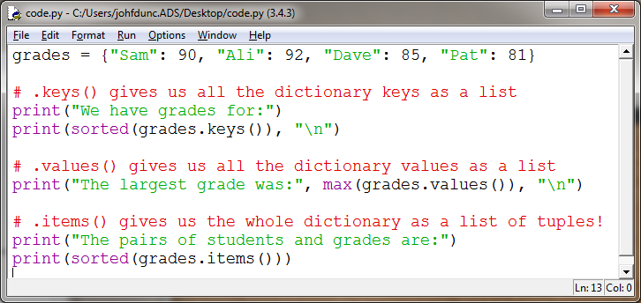
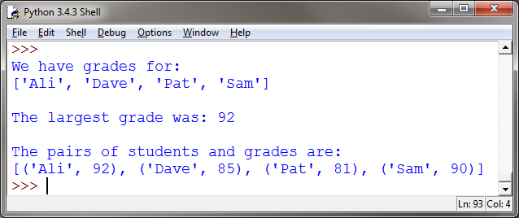
Quick Review – Dictionary Methods

Slide 47
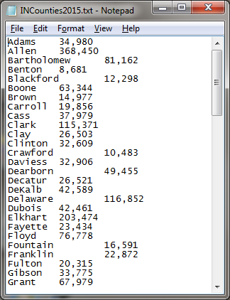
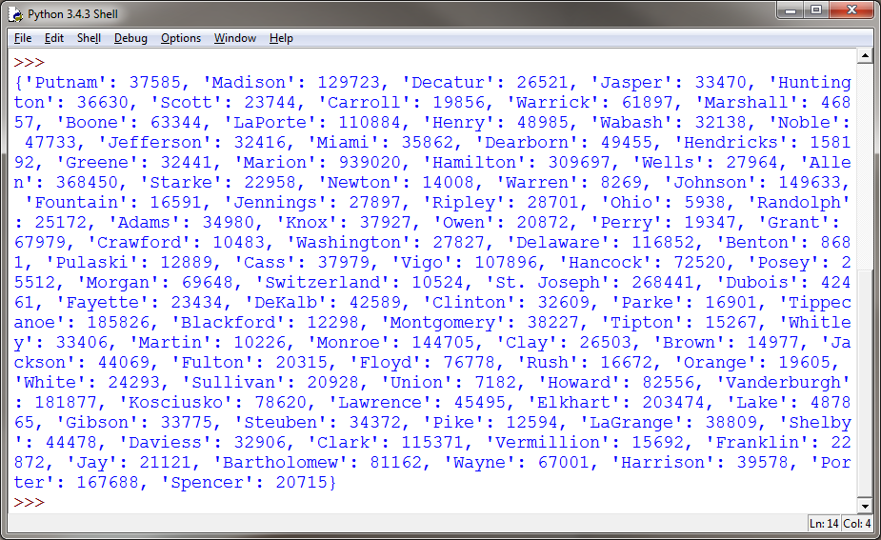
IN Counties pt 1 (Group Work)
Download INCounties2015.txt – this file contains statistical data about the population of Indiana’s counties in 2015.
Write a program that can load this data into a dictionary.

Slide 48
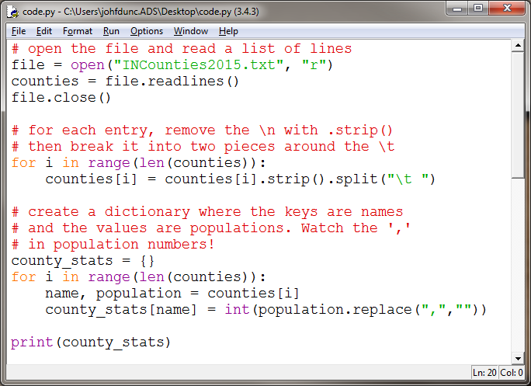
IN Counties pt 1 (Solution 1)

Slide 49
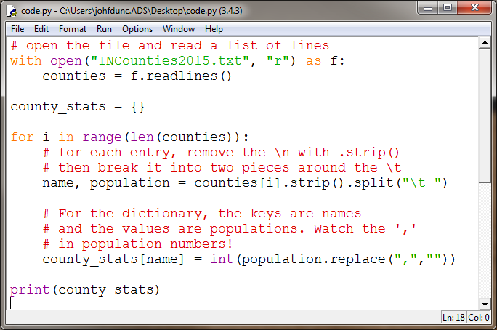
IN Counties pt 1 (Solution 2)

Slide 50
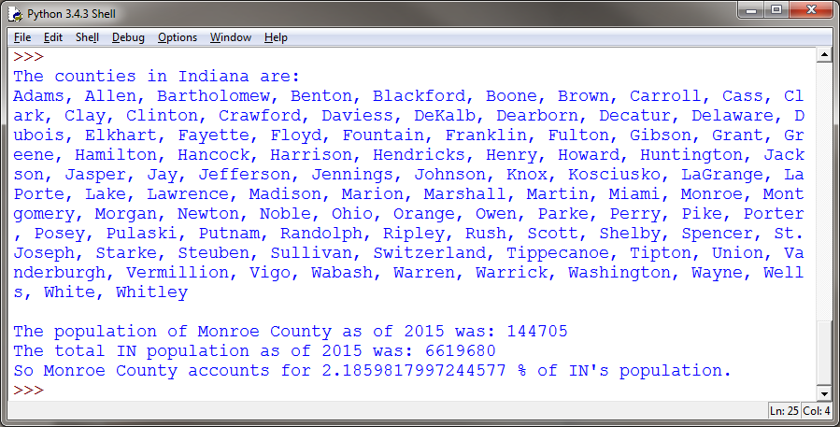
IN Counties pt 2 (Group Work)
Now, use your dictionary to output this information:

Slide 51
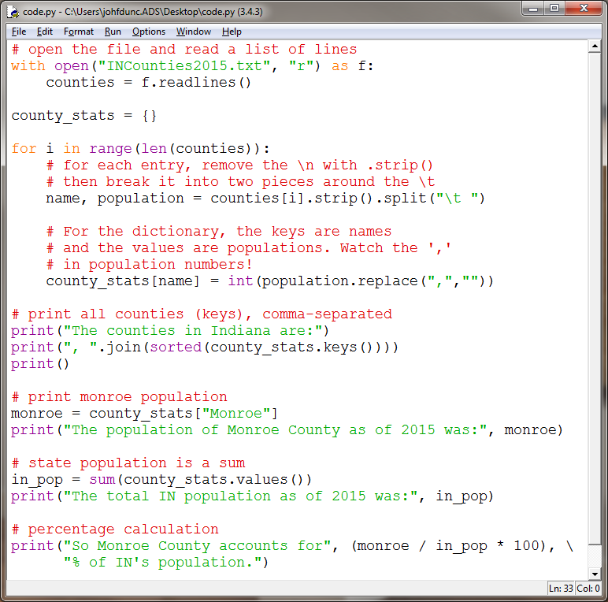
IN Counties pt 2 (Solution)

Slide 52
Questions?

